Slide 1

CS144 An Introduction to Computer Networks
Routing – Lecture 2
Nick McKeown
Professor of Electrical Engineering
and Computer Science, Stanford University
Notes:
You will remember from an earlier video that if a network is carrying only one flow, AIMD will keep the bottleneck link full all the time, and therefore we say the throughput is equal to the data rate of the bottleneck link. Nice and simple.
Things get quite a bit more complicated if the network is carrying lots of AIMD flows, all sharing a bottleneck link. In this video, I am going to derive a throughput formula for AIMD with multiple flows sharing the network. This video contains more equations than most of the videos, so keep your wits about you and keep a close eye on the assumptions I am making as I go along.

Slide 2
Another view of Dijkstra…

Slide 3
A
3
4
R₁
4
R₃
R₂
4
3
2
R₄
R₅
2
4
B

Slide 4
A
R₁
R₃
R₂
R₄
R₅
B

Slide 5
A
3
R₁
4
4
R₂
R₃
4
2
3
R₄
R₅
4
2
B

Slide 6
Internet routing is hierarchical

Slide 7

In the Internet, Autonomous Systems (AS’s) have Border Routers (orange).
The border routers route packets to each other using the Border Gateway Protocol.
Hurricane Electric (he.net)
JANET (ja.net)
(transatlantic cable)
yuba.stanford.edu
Stanford University
Cambridge University (UK)

Slide 8
In the Internet, Autonomous Systems (AS’s) have Border Routers (orange).
The border routers route packets to each other using the Border Gateway Protocol.
Hurricane Electric (he.net)
JANET (ja.net)
(transatlantic cable)
nickm@yuba.Stanford.EDU > traceroute -q1 www.cam.ac.uk
traceroute to www.cam.ac.uk (128.232.132.8), 30 hops max, 40 byte packets
1 csee-west-rtr-vl3874.SUNet (171.64.74.2) 0.229 ms
2 he-rtr-vlan12.SUNet (171.66.0.209) 1.531 ms
3 100ge5-1.core1.pao1.he.net (184.105.177.237) 0.638 ms
4 10ge7-5.core1.sjc2.he.net (72.52.92.70) 1.311 ms
5 100ge10-2.core1.nyc4.he.net (184.105.81.217) 62.771 ms
6 100ge16-2.core1.lon2.he.net (72.52.92.165) 145.243 ms
7 linx-gw1.ja.net (195.66.224.15) 136.102 ms
8 ae23.londtt-sbr1.ja.net (146.97.35.169) 135.434 ms
9 […]
12 uoc.ja.net (146.97.41.38) 169.232 ms
13 d-dw.s-dw.net.cam.ac.uk (193.60.88.2) 142.827 ms
14 […]
SJC
NYC
London
yuba.stanford.edu
Stanford University
Cambridge University (UK)

Slide 9
In the Internet, Autonomous Systems (AS’s) have Border Routers (orange).
The border routers route packets to each other using the Border Gateway Protocol.
Hurricane Electric (he.net)
JANET (ja.net)
(transatlantic cable)
nickm@yuba.Stanford.EDU > traceroute -q1 www.cam.ac.uk
traceroute to www.cam.ac.uk (128.232.132.8), 30 hops max, 40 byte packets
1 csee-west-rtr-vl3874.SUNet (171.64.74.2) 0.229 ms
2 he-rtr-vlan12.SUNet (171.66.0.209) 1.531 ms
3 100ge5-1.core1.pao1.he.net (184.105.177.237) 0.638 ms
4 10ge7-5.core1.sjc2.he.net (72.52.92.70) 1.311 ms
5 100ge10-2.core1.nyc4.he.net (184.105.81.217) 62.771 ms
6 100ge16-2.core1.lon2.he.net (72.52.92.165) 145.243 ms
7 linx-gw1.ja.net (195.66.224.15) 136.102 ms
8 ae23.londtt-sbr1.ja.net (146.97.35.169) 135.434 ms
9 […]
12 uoc.ja.net (146.97.41.38) 169.232 ms
13 d-dw.s-dw.net.cam.ac.uk (193.60.88.2) 142.827 ms
14 […]
nickm@yuba.Stanford.EDU > traceroute -q1 www.cam.ac.uk
traceroute to www.cam.ac.uk (128.232.132.8), 30 hops max, 40 byte packets
1 csee-west-rtr-vl3874.SUNet (171.64.74.2) 0.229 ms
2 he-rtr-vlan12.SUNet (171.66.0.209) 1.531 ms
3 100ge5-1.core1.pao1.he.net (184.105.177.237) 0.638 ms
4 10ge7-5.core1.sjc2.he.net (72.52.92.70) 1.311 ms
5 100ge10-2.core1.nyc4.he.net (184.105.81.217) 62.771 ms
6 100ge16-2.core1.lon2.he.net (72.52.92.165) 145.243 ms
7 linx-gw1.ja.net (195.66.224.15) 136.102 ms
8 ae23.londtt-sbr1.ja.net (146.97.35.169) 135.434 ms
9 […]
12 uoc.ja.net (146.97.41.38) 169.232 ms
13 d-dw.s-dw.net.cam.ac.uk (193.60.88.2) 142.827 ms
14 […]
Stanford University
Cambridge University (UK)

Slide 10
AS (Autonomous System) numbers
nickm@yuba.Stanford.EDU > traceroute -q1 www.cam.ac.uk
traceroute to www.cam.ac.uk (128.232.132.8), 30 hops max, 40 byte packets
1 csee-west-rtr-vl3874.SUNet (171.64.74.2) 0.229 ms
2 he-rtr-vlan12.SUNet (171.66.0.209) 1.531 ms
3 100ge5-1.core1.pao1.he.net (184.105.177.237) 0.638 ms
4 10ge7-5.core1.sjc2.he.net (72.52.92.70) 1.311 ms
5 100ge10-2.core1.nyc4.he.net (184.105.81.217) 62.771 ms
6 100ge16-2.core1.lon2.he.net (72.52.92.165) 145.243 ms
7 linx-gw1.ja.net (195.66.224.15) 136.102 ms
8 ae23.londtt-sbr1.ja.net (146.97.35.169) 135.434 ms
9 […]
12 uoc.ja.net (146.97.41.38) 169.232 ms
13 d-dw.s-dw.net.cam.ac.uk (193.60.88.2) 142.827 ms
14 […]
nickm> whois -h whois.cymru.com 146.97.35.169
AS | IP | AS Name
786 | 146.97.35.169 | JANET Jisc Services
Limited, GB
JANET is AS 786
e.g. yuba.Stanford.edu
nickm> whois -h whois.cymru.com 171.64.74.155
AS | IP | AS Name
32 | 171.64.74.155 | STANFORD, US
Stanford is AS 32
Notes:
Try traceroute -a www.cam.ac.uk. See multipath!!!
Try myipaddress.com
How does default routing work in an institution?

Slide 11
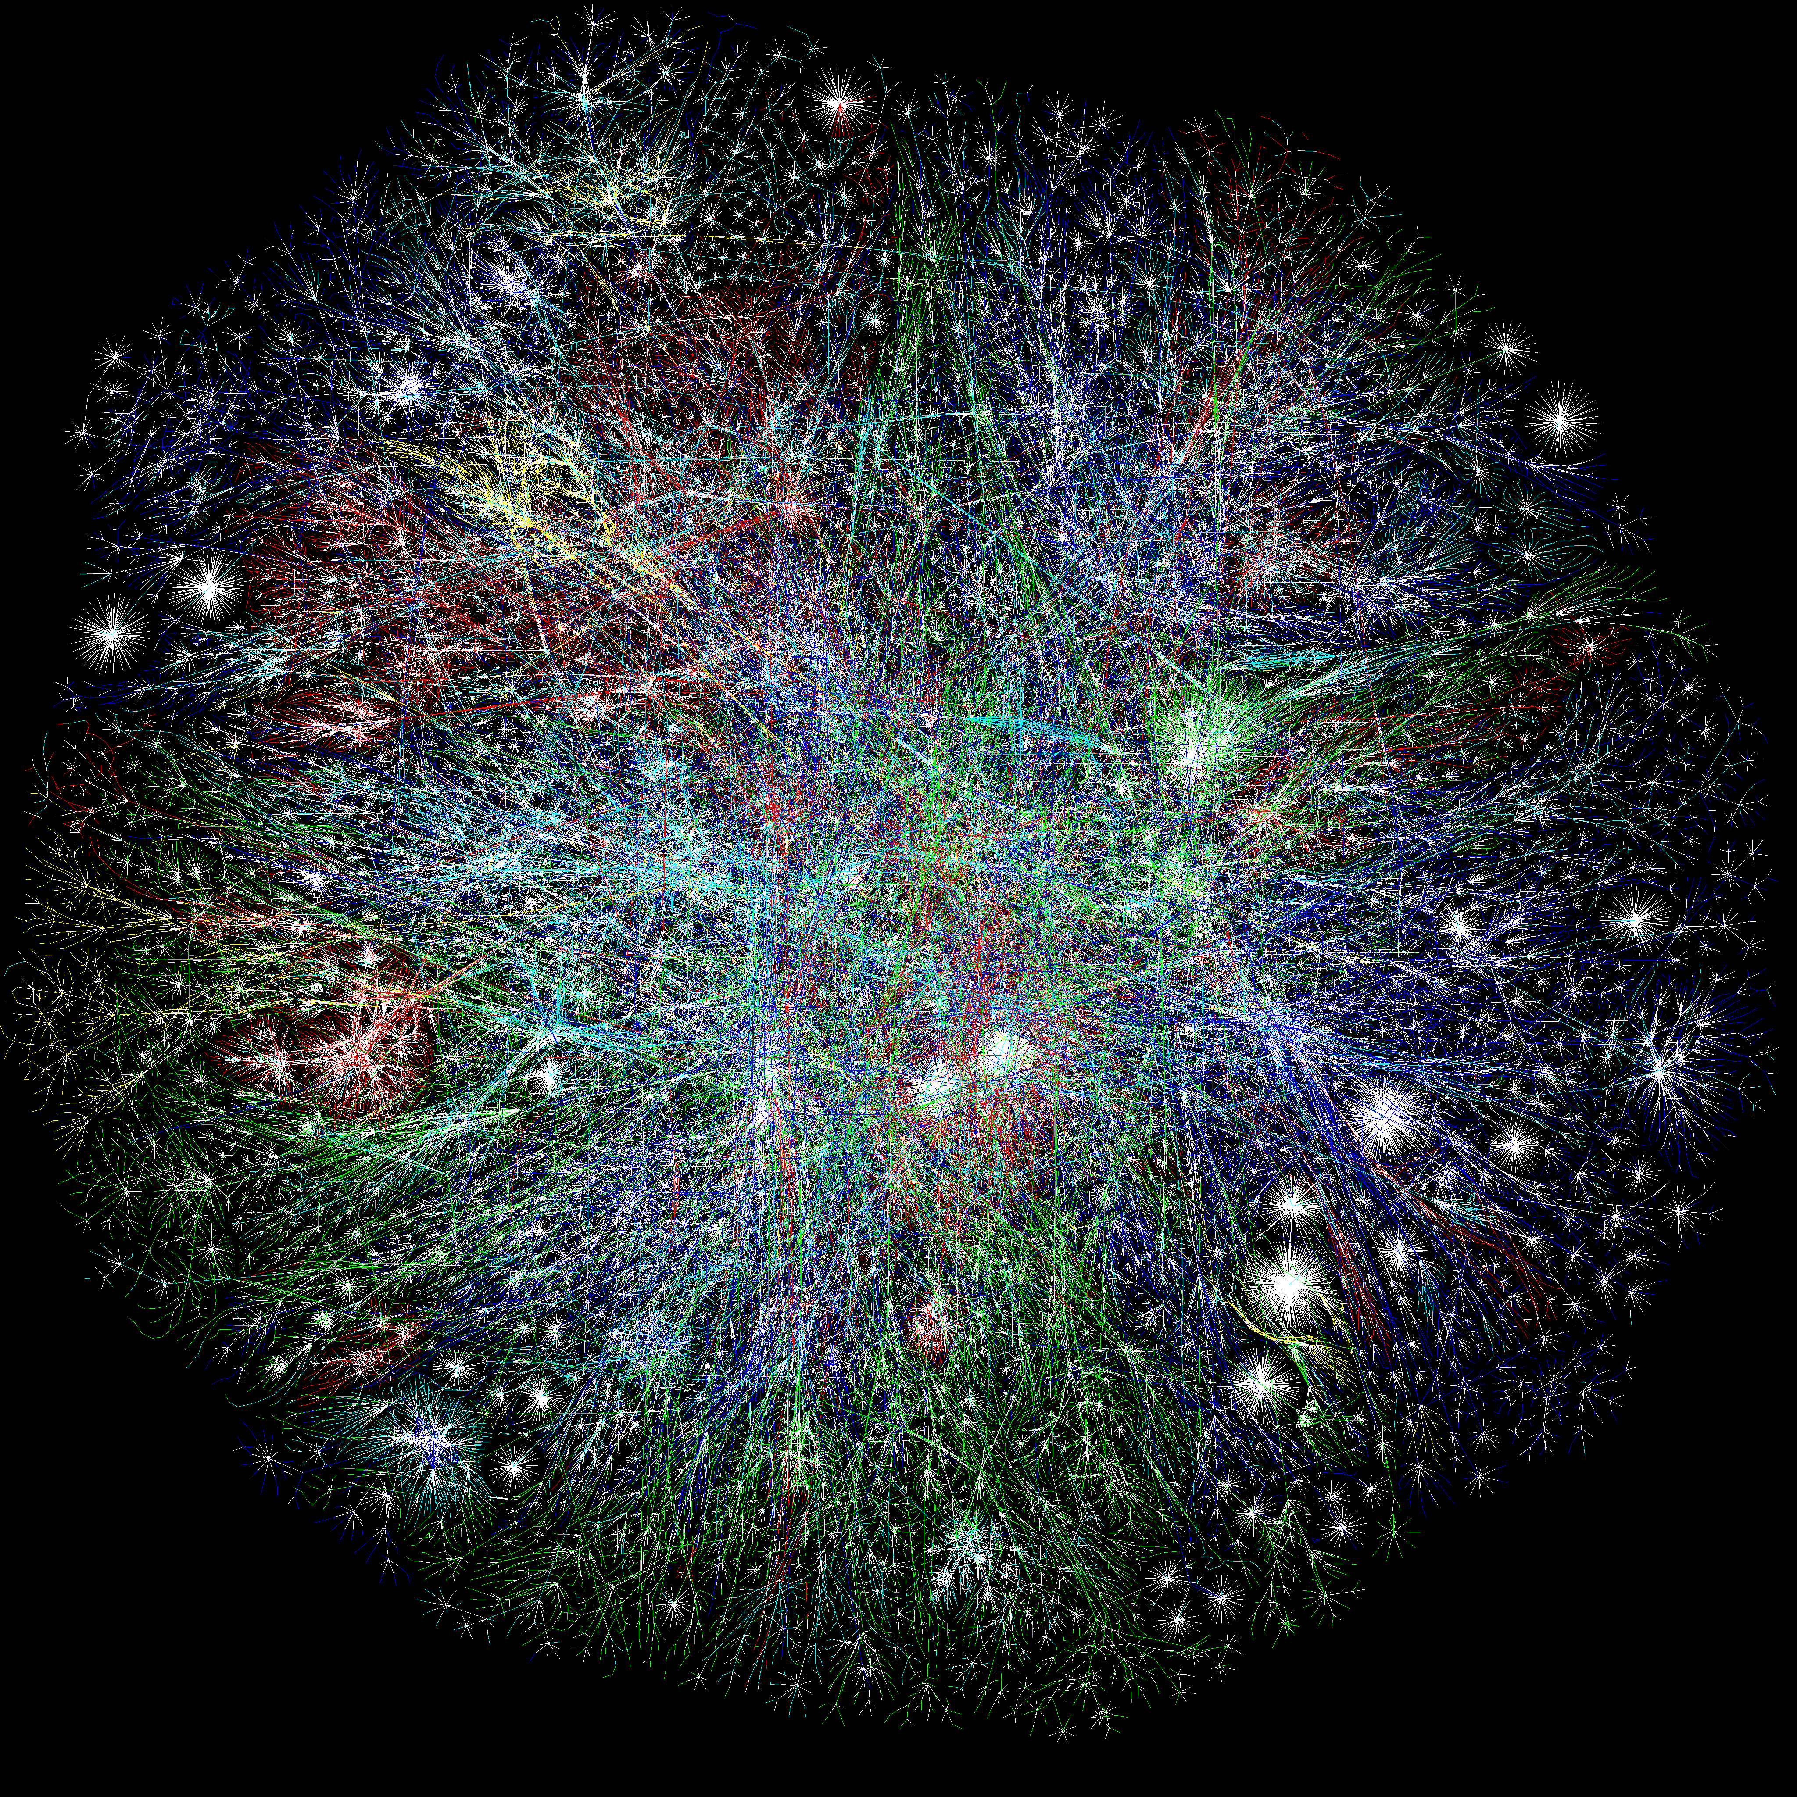

Slide 12
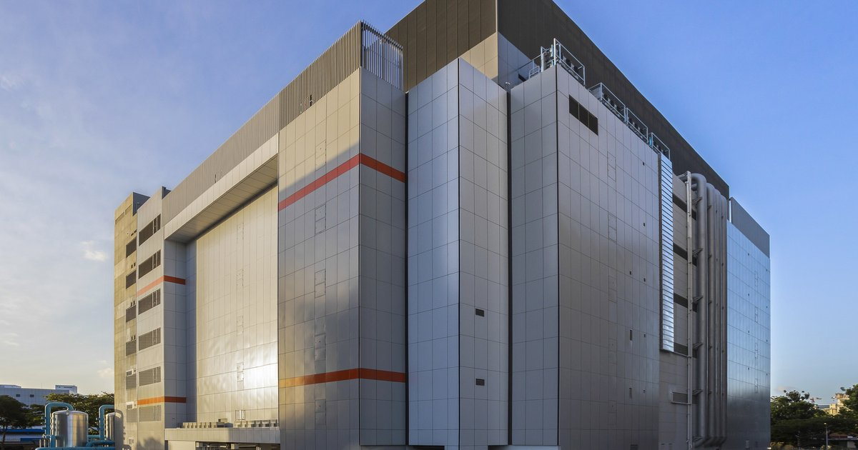
Autonomous Systems (AS’s) usually connect to each other
in an Internet eXchange Point (IXP)
Hurricane Electric (he.net)
JANET (ja.net)
(transatlantic cable)
An IXP
There are hundreds of IXPs worldwide
yuba.stanford.edu
Stanford University
Cambridge University (UK)

Slide 13
Autonomous Systems (AS’s) usually connect to each other
in an Internet eXchange Point (IXP)
Hurricane Electric (he.net)
he.net
AS 6939
Level3
AS 3356
Stanford
AS 32
CENIC
AS 2152
yuba.stanford.edu
Stanford University
Other ISPs at local IXP

Slide 14
Autonomous Systems (AS’s) usually connect to each other
in an Internet eXchange Point (IXP)
Hurricane Electric (he.net)
he.net
AS 6939
Ethernet Switch(es)
Provided by IXP
Peering relationship:
BGP session (over TCP)
Could be paid or settlement-free
Level3
AS 3356
Stanford
AS 32
CENIC
AS 2152
yuba.stanford.edu
Stanford University
Other ISPs at local IXP

Slide 15
Border Gateway Protocol (BGP)
BGP routers advertise routes to their neighbors, containing:
A prefix
The list of AS’s indicating the path the packet will take to reach the prefix
Example of path advertisement:
“The network 171.64/16 can be reached via the path {AS1, AS5, AS13}”
Q: Why advertise a path of AS’s for each prefix, rather than
a. The next hop for each prefix
b. The path of IP addresses

Slide 16
Border Gateway Protocol (BGP)
“The network 171.64/16 can be reached via the path {AS1, AS5, AS13}”
Paths with loops are detected locally and ignored.
A BGP router may connect to several peers and receive multiple different advertised paths for the same prefix.
Local policies chosen by the AS administrator pick the preferred path.

Slide 17
Border Gateway Protocol (BGP): Details
BGP neighbors (“peers”) establish a TCP connection.
The TCP connection is manually configured at both ends.
Neighbors send “keepalive” messages every 60 seconds.
BGP is sometimes called a “Path vector” algorithm.
It is not a link-state or a distance-vector routing protocol.
When an advertised path changes, the path vector is first “withdrawn”, then the new one is advertised.

Slide 18
Customers and Providers
provider
provider
customer
IP traffic
customer
Customers pay providers to carry their packets.

Slide 19
Customer-Provider Hierarchy
Transit AS’s
Routers inside Stub AS’s can use a
“default route” for unknown IP addresses.
The default route is the Border router.
Stub AS’s
provider
customer
IP traffic

Slide 20
The Peering Relationship
peer
peer
Peers provide transit between
their respective customers
Peers do not provide transit
between peers
Peers (typically) do not exchange $$$
provider
customer
traffic
allowed
Transit traffic NOT
allowed
So how does traffic from the left side reach the right side?

Slide 21
“Tier 1” Providers
A Tier 1 network is a transit-free network that peers with every other tier 1 network
“Tier 1”
“Tier 1”
“Tier 1”
“Tier 1”

Slide 22
Tier 1 ISPs
Definition: A Tier 1 ISP has access to the entire Internet Region solely via its free and reciprocal peering agreements.
Definition: An Internet Region is a portion of the Internet network typically bounded by a country's geographical boundaries.
Each Internet Region has its own set of "Tier 1 ISPs.”
The litmus test:
"Does an ISP pay anyone to reach any destination in the Internet Region?" If the answer is "No" then it is a Tier 1 ISP, and If the answer is "Yes" then it is a Tier 2 ISP.

Slide 23
Tier 1 ISPs by country
The U.S. Internet Region Tier 1 ISPs
AT&T
Verizon
Sprint (Softbank Broadband)
Century Link (Qwest)
Level 3 (with Global Crossing now)
NTT/Verio
Cogent
The Japan Internet Region Tier 1 ISPs
NTT
Japan Telecom (Softbank)
KDDI
IIJ
Powered.com

Slide 24
“Tier 1”
“Tier 1”
“Tier 1”
peer
peer
Peers provide transit between
their respective customers
Peers do not provide transit
between peers
Peers (typically) do not exchange $$$
provider
customer
traffic
allowed
Transit traffic NOT
allowed

